Slide 1
The EXOMHYDR project at the Space Research Centre
EXOMHYDR = Magmatic plumbing systems and tectonic control of hydrothermal activity on Mars
revealed by ExoMars/TGO: constraints for life and resources
01.12.2017-20.11.2020
Jakub Ciążela, Marta Ciążela, Joanna Gurgurewicz, Daniel Mège, Pierre-Antoine "Pat" Tesson
Kinga Gancarczyk, Elżbieta Konopka

Slide 2
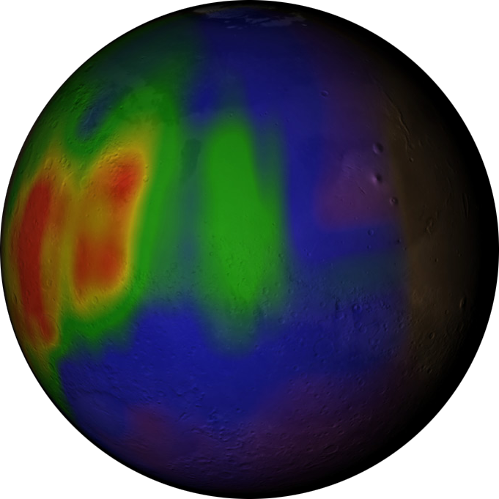
At the beginning...
... was methane detection
in the atmosphere of Mars.
Formisano et al 2004
Mumma et al. 2009 => 30 ppbv
Fonti and Marzo 2010 => 80 ppbv
Webster et al. 2015 => 10ppbv (Curiosity)

Slide 3
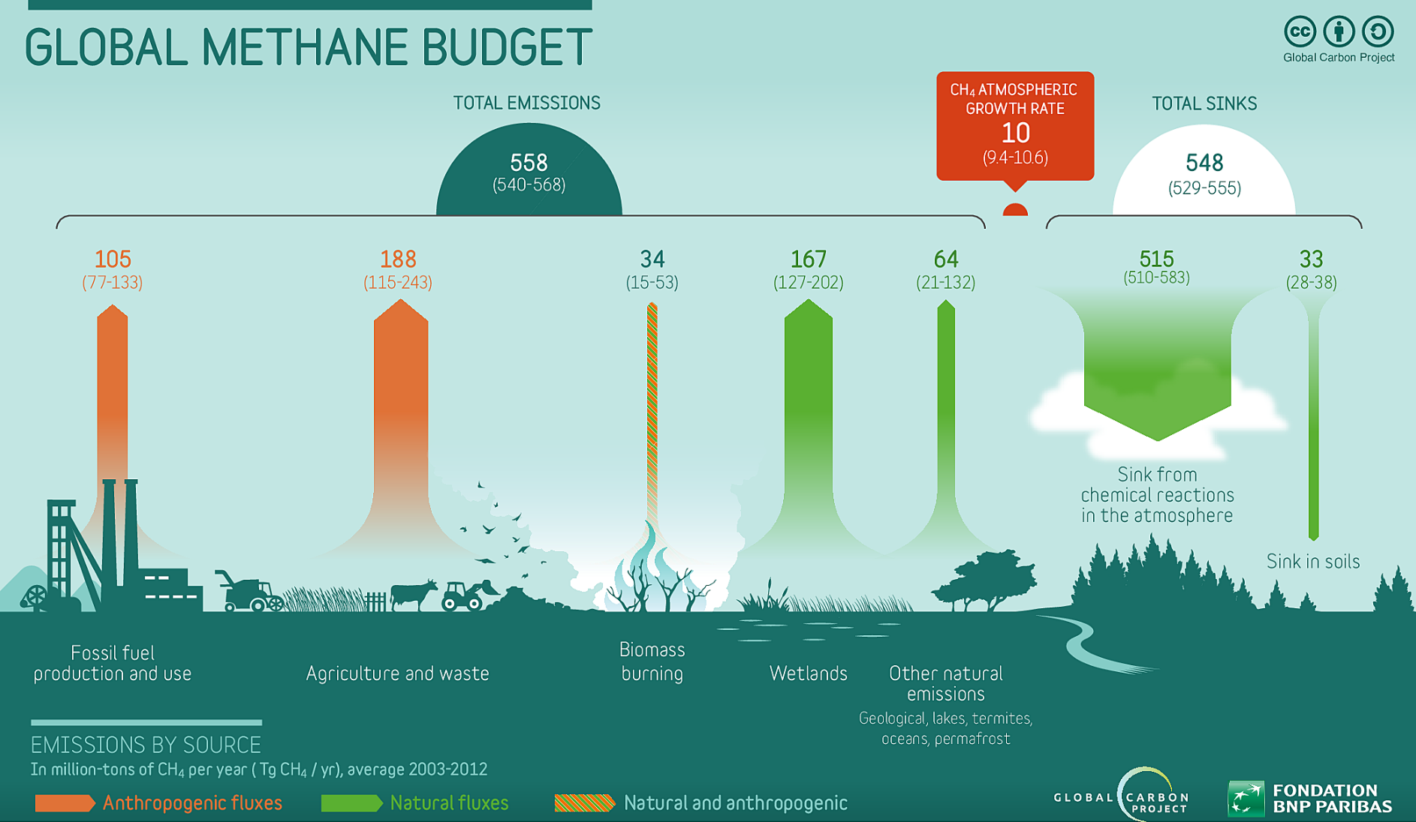
How is methane produced on Earth?

Slide 4
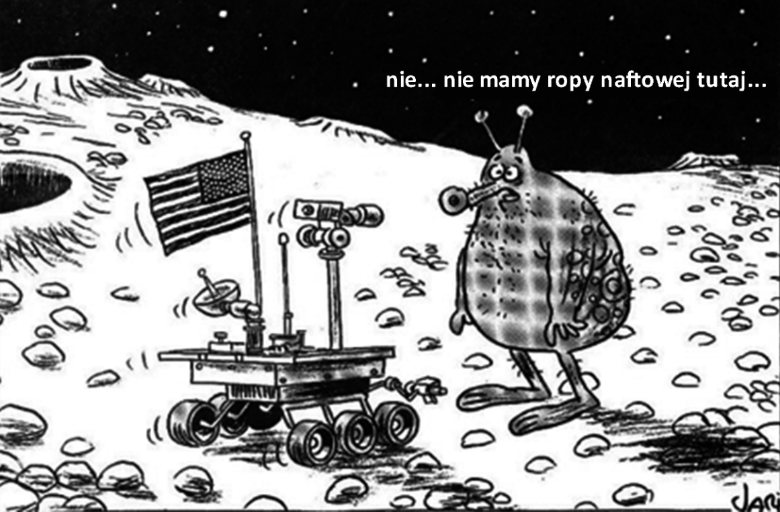
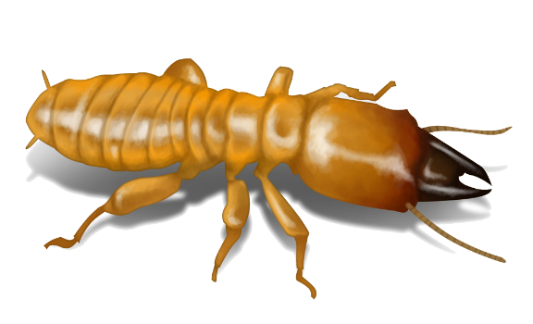
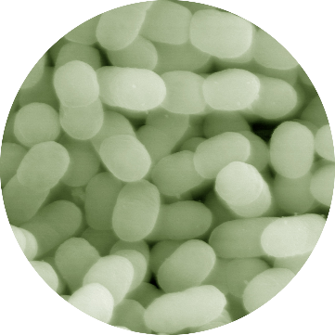
How is methane produced on Mars?
Biology?
Geology?
beasts
insects
maybe.
Let's be creative.
archaea

Slide 5
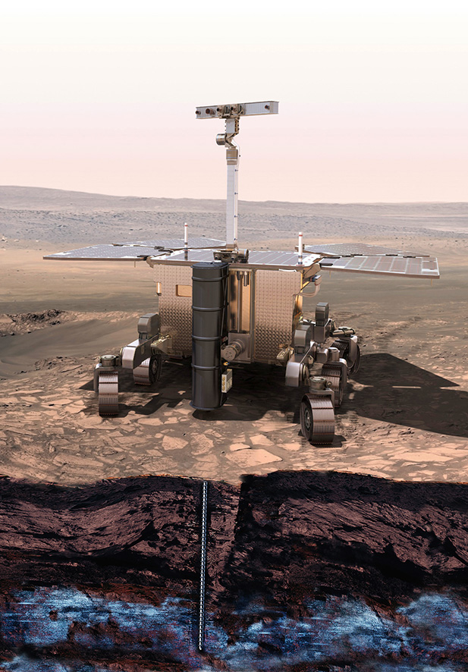
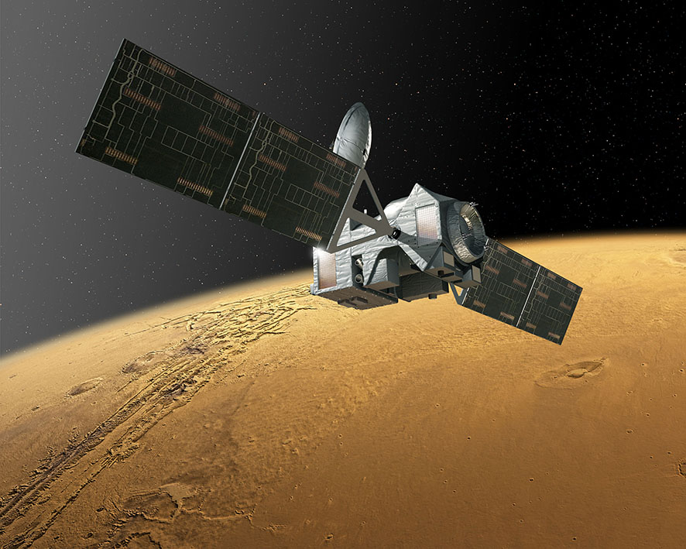
The ExoMars Programme
Rover
(2020)
Trace Gas Orbiter
(2016)
Science operations started in May 2018

Slide 6
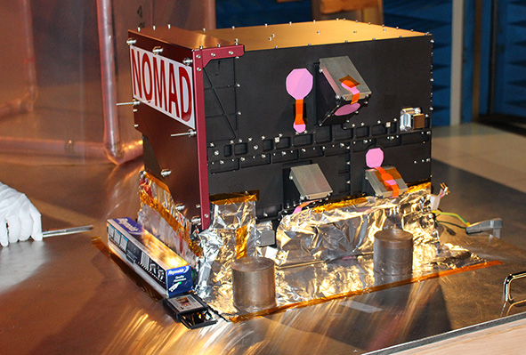
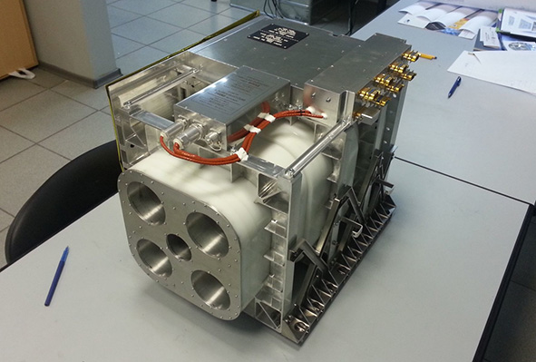
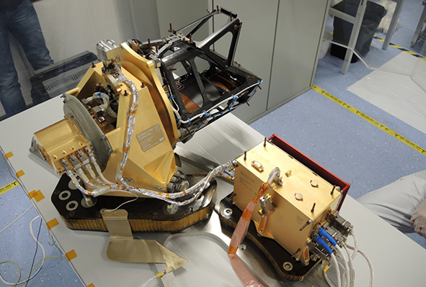
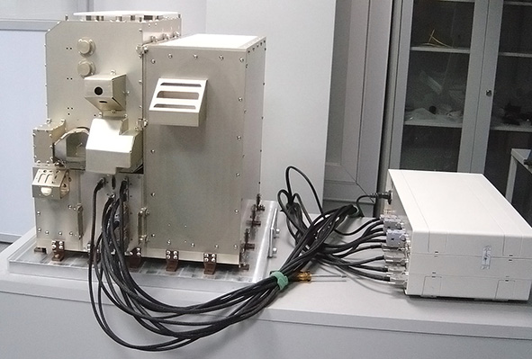
Trace Gas Orbiter
NOMAD (IASB)
UV, NIR
ACS (IKI)
NIR, MIR, TIR
CaSSIS (UBern)
4-ch stereo camera
FREND (IKI)
epithermal neutrons
CBK

Slide 7
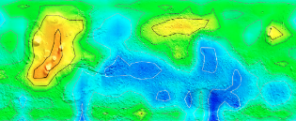
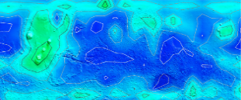
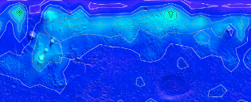
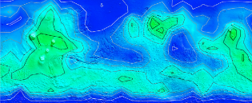
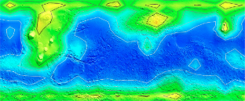
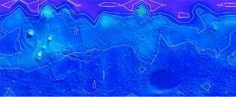
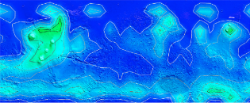
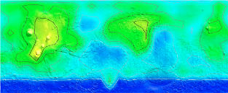
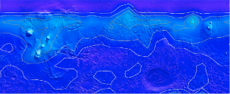
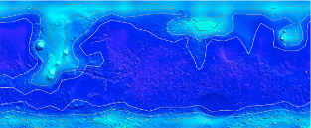
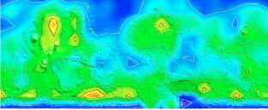
What kind of geologic sites do release methane?
80
ppbv
0
3 Martian years (2061 Earth days)
Fonti and Marzo 2010

Slide 8
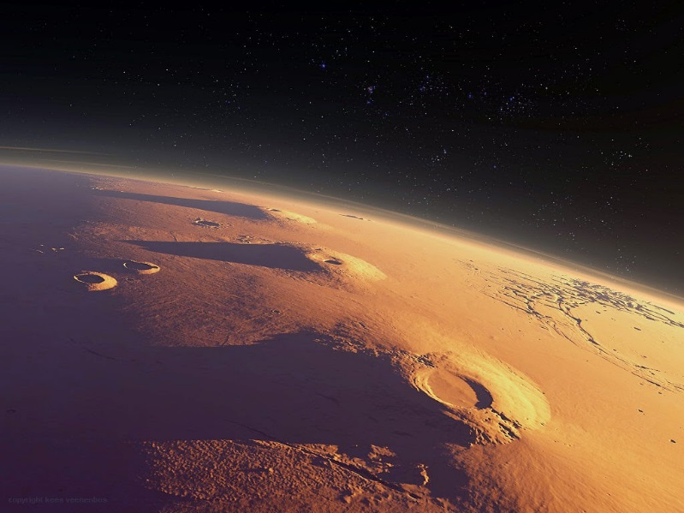
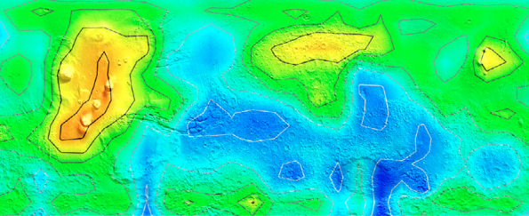
Methane sites
Tharsis Montes
Seasonal changes
Mid- to high latitudes
Volcanic regions
80
35°N
ppbv
0
55°S
LATITUDES > 30°
VOLCANOES

Slide 9
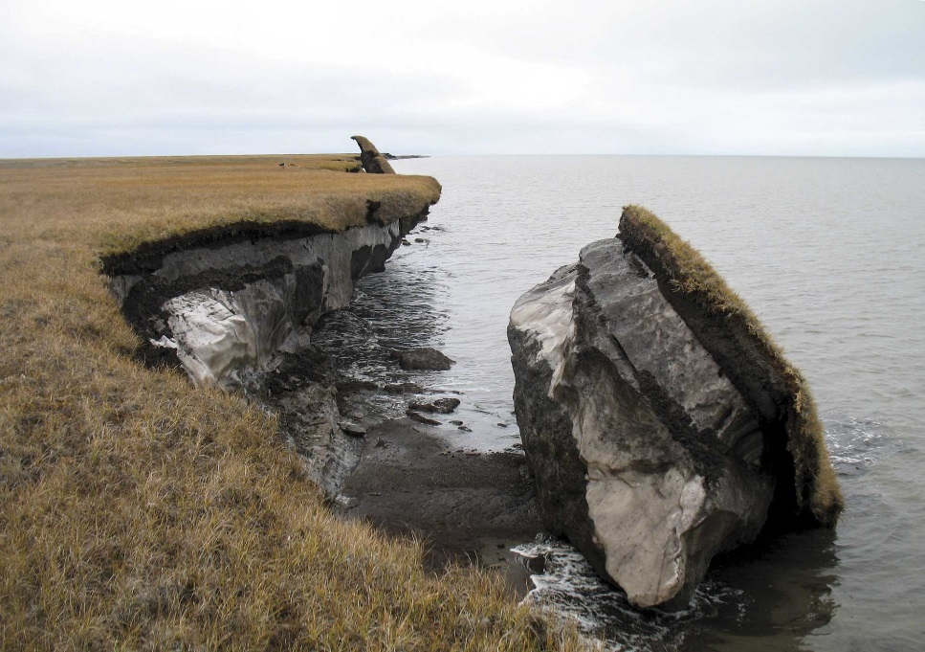
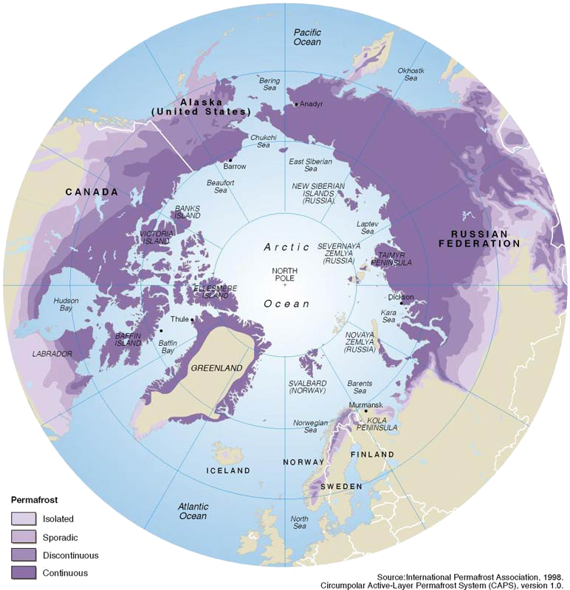
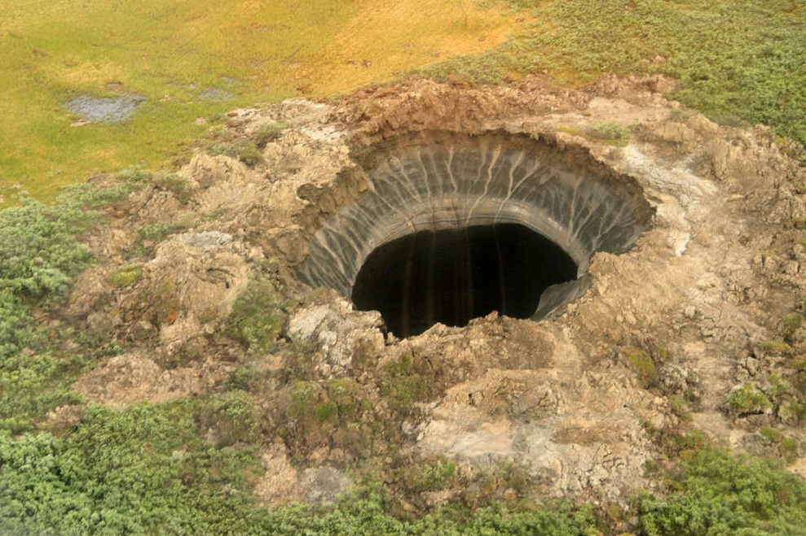
Mid- to high latitudes
Permafrost regions on Earth
Barter Island, Alaska
© USGS
2014
CH₄
Yamal peninsula, Russia
Credit: Yamalo-Nenets Autonomous Okrug Governor

Slide 10
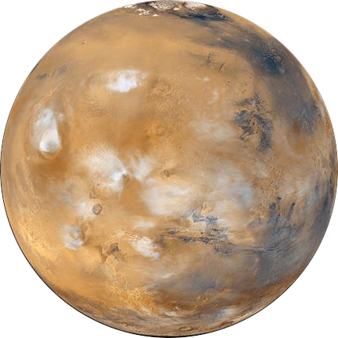
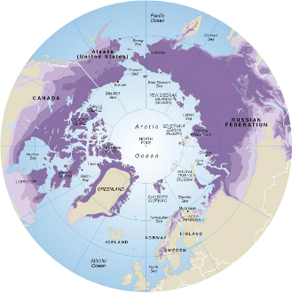
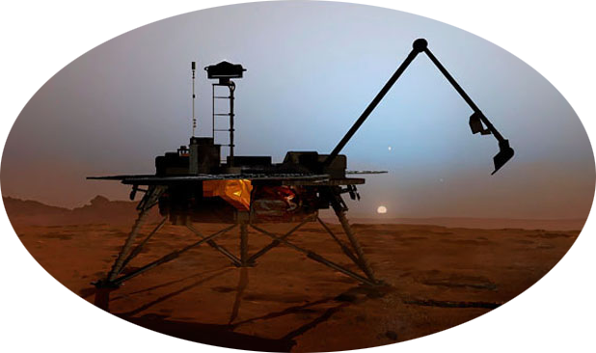
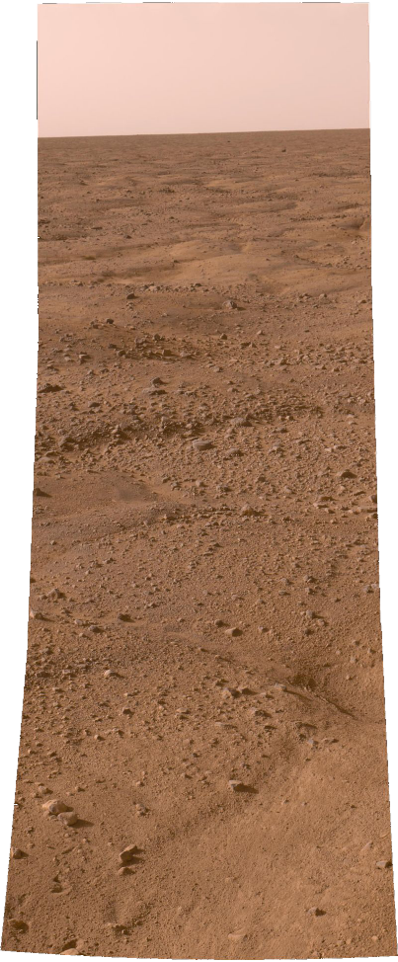
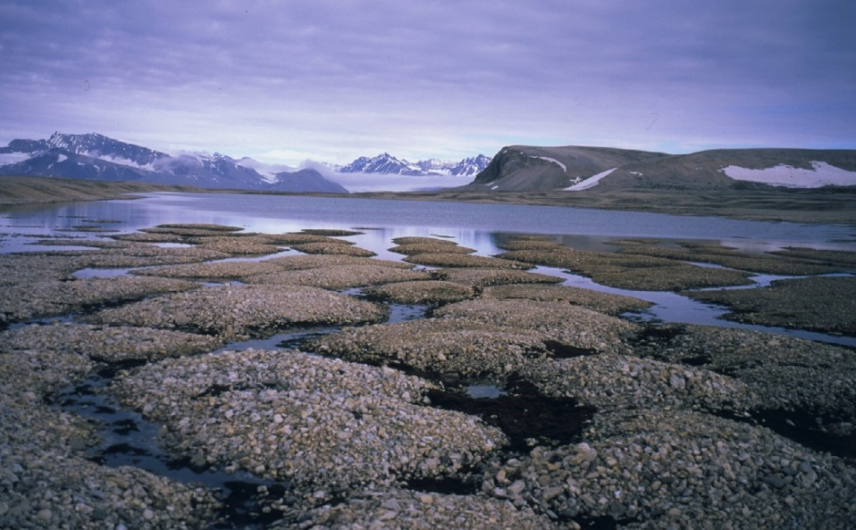
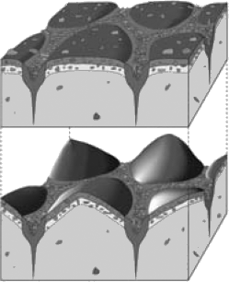
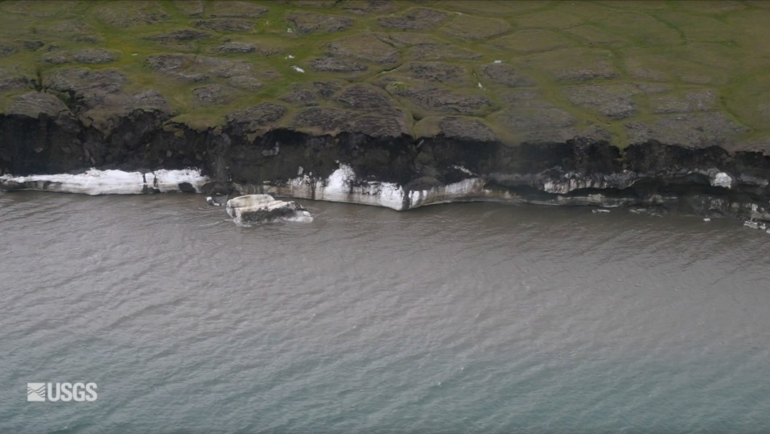
Phoenix landing site (2008)
Barter Island, Alaska
Mid- to high latitudes
Kvadehuksletta,
Svalbard
Svalbard
Sublimation polygons
© Ólafur Ingólfsson
Alaska
permafrost
Levy et al. 2011
ice wedges
ice layer

Slide 11
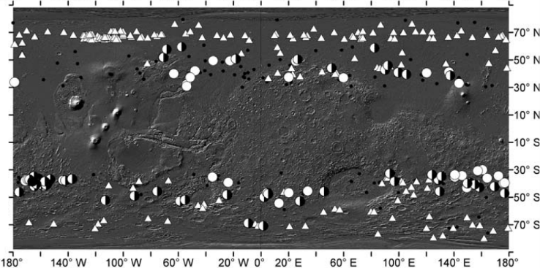
Phoenix landing site (2008)
Mid- to high latitudes
distribution
of polygons on Mars
Levy et al. 2011
latitude distribution
of detected methane
Fonti and Marzo 2010

Slide 12
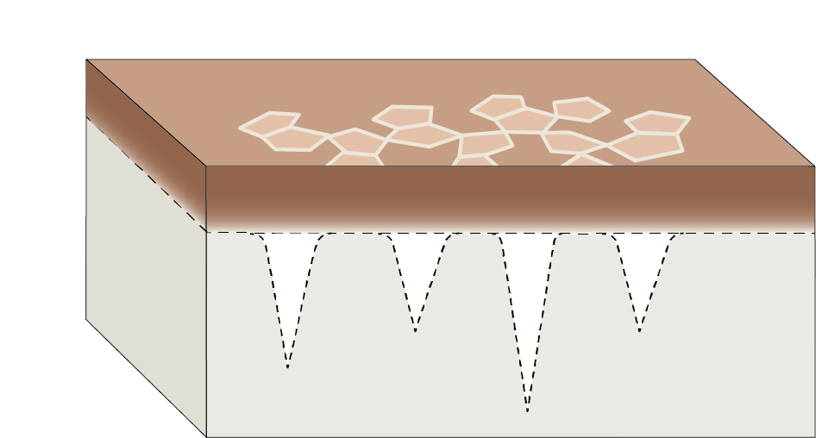
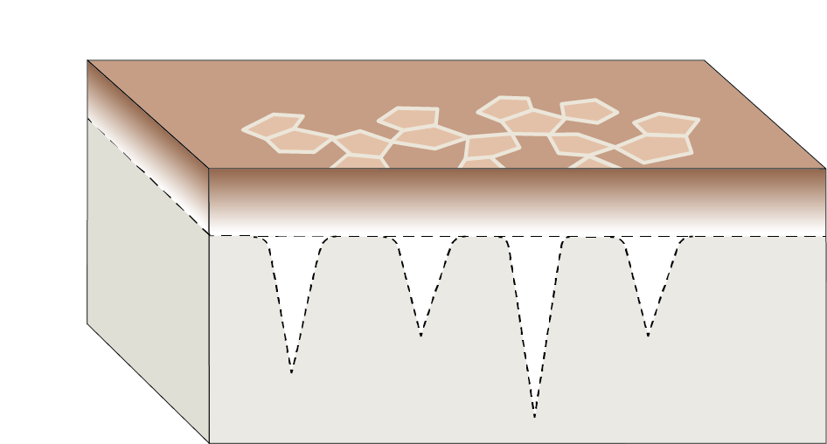
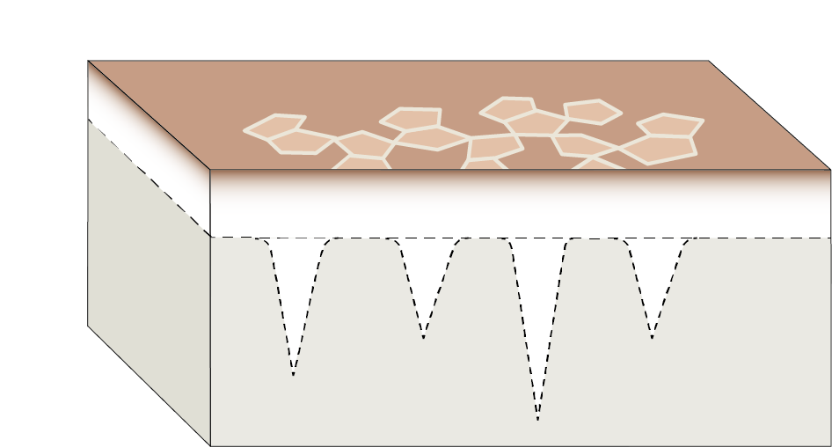
Mechanisms of methane release at mid- high latitude
thawing
1. Release of trapped methane
SUMMER
release of trapped CH₄
ice
freezing
WINTER
permafrost

Slide 13
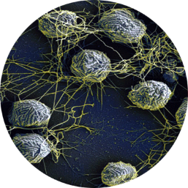
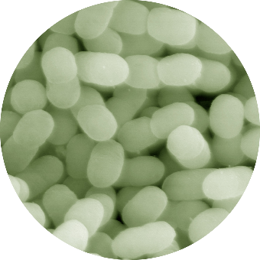
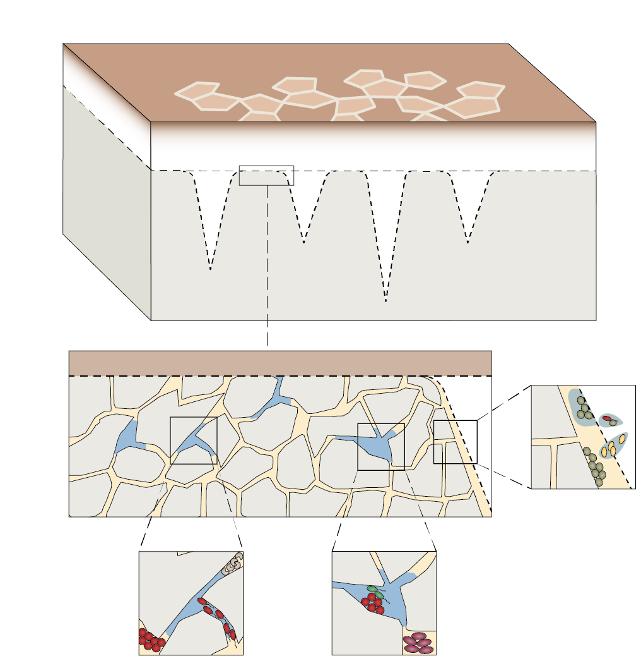
SUMMER
CH₄ release by
methanogens
CH₄ absorption by
methanotrophs
Methanocaldococcus
villosus
Methylobacter luteus
2. Bacterial activity
thawing
trapped CH₄ release
ice
permafrost
Jansson and Tas 2014

Slide 14
Mid- to high latitudes
CH₄ in atmosphere
=
release of CH₄ trapped in permafrost
+
activity of methanogens
-
activity of methanotrophs

Slide 15
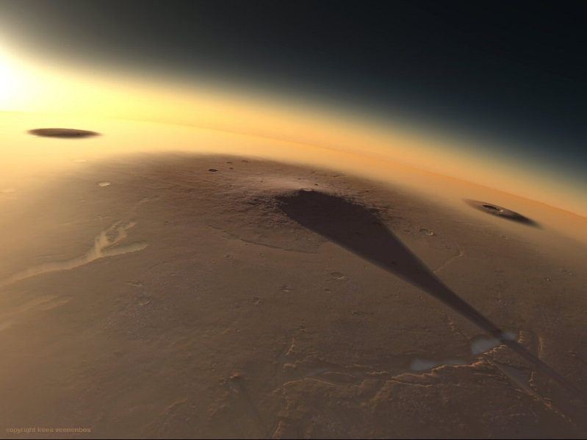
Volcanoes
Seasonal cycle
Persistence in the major volcanic regions
Tharsis Montes
Elysium Mons

Slide 16
How is CH₄ connected with volcanoes?
Alteration of magmatic rocks (serpentinisation)
Hydrothermal activity

Slide 17
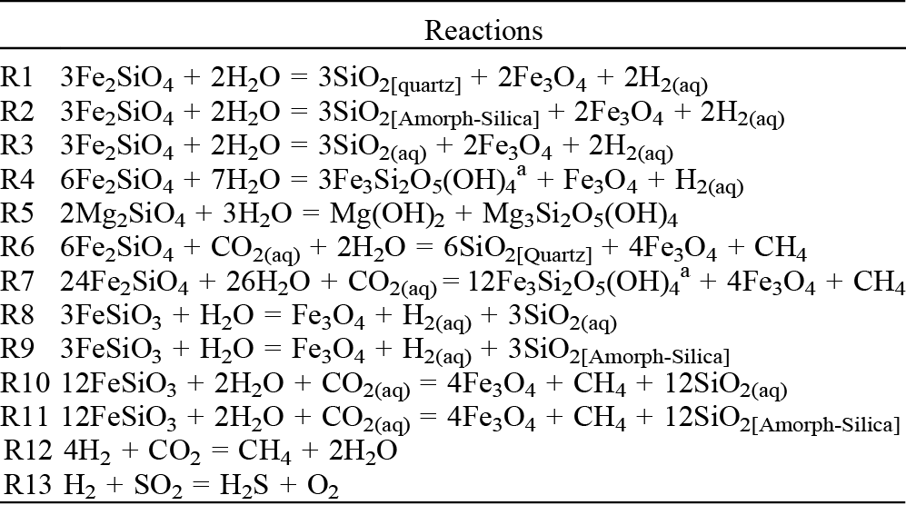
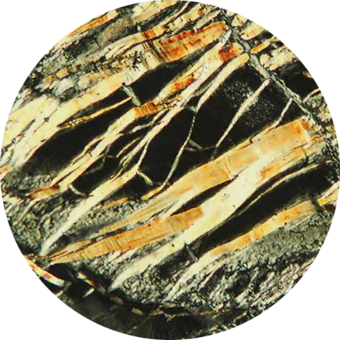
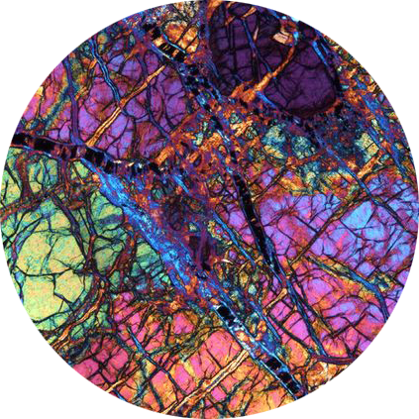
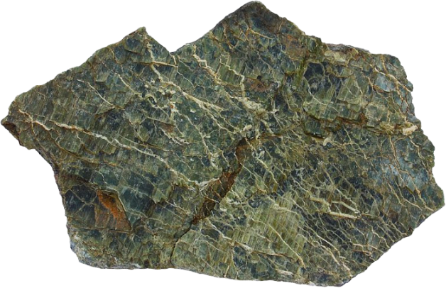
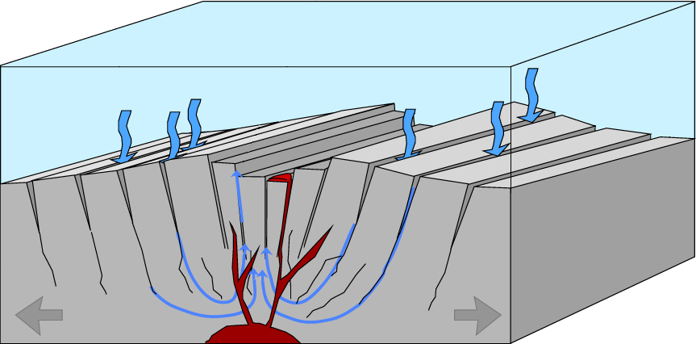
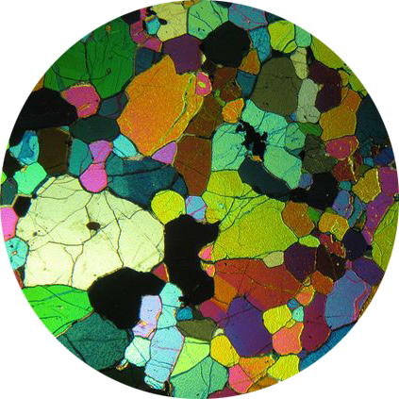
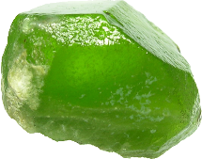
Serpentinisation
Oze and Sharma 2005
serpentine + CH₄
Terrestrial
ocean spreading centres
under the microscope
H₂O
H₂O
water alteration
olivine
© B. Raislback

Slide 18
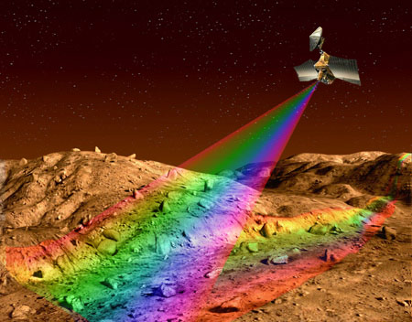
MRO/CRISM
Serpentinisation
Serpentine detected from orbit using spectral data
Ehlmann et al. 2009
Viviano-Beck et al. 2014

Slide 19
Hydrothermal activity
snow
rain
hot spring
geyser
mineralisations
hot spring
geyser
mineralisations
surface
20°C
cold water
100 m – 2 km
100°C
200°C
Hot magma
hot
groundwater
cold
groundwater

Slide 20
Where are hydrothermal sites?
Areas where surface water is abnormally hot: Hot springs, hot pools, geysers...
Heat is provided by magma plumbing system (i.e. tectonics): magma chambers, volcanic conduits (dykes, sills)...
AT OCEAN
SPREADING CENTRES
CH₄
fracture trace
NE Atlantic margin
© B. Raislback
NOAA Okeanos Explorer Program 2013
Mid-Atlantic Ridge
Gulf of southern California
Known and sampled hydrothermal sites
along oceaning spreading centers
Centre of Geobiology, Bergen
© MBARI, 2015

Slide 21
IN CONTINENTAL
VOLCANIC REGIONS
1. Surface fracturing
Dabbahu fissure, September 2005
Photo Cynthia Ebinger
Photo Julie Rowland

Slide 22
IN CONTINENTAL
VOLCANIC REGIONS
2. Eruption
What they missed!
(Bárðarbunga volcano, Iceland, Sept 2014)

Slide 23
3. Hydrothermal circulation, mineralisations, extremophile activity
2018
Dallol
Feb-Jun 2005
Dabbahu
Sept 2005

Slide 24
3. Hydrothermal circulation, mineralisations, extremophile activity
mineralisations
extremophiles

Slide 25
Ruff et al. 2011
Where are hydrothermal sites located on Mars?
Magmatic plumbing system

Slide 26
Hydrothermal activity
Tharsis Montes
Tharsis giant volcanoes
flood basalt (red and violet)
Terrestrial large volcanic provinces
Elysium Mons
Ernst 2014

Slide 27
Tharsis Montes
Hydrothermal activity at the Tharsis volcanoes
Possible hydrothermal vents
1500 km
Mège and Masson 1996

Slide 28
Iceland (Laki)
Arsia Mons
7.02.1784
volcanic fissure
Arsia Mons
1 km
200 km
Themis day IR/MOLA DEM

Slide 29
Ascraeus Mons
Ascraeus Mons
volcanic fissure
volcanic flows and fissures
5 km
50 km
Themis day IR/MOLA DEM

Slide 30
Alba Patera
Alba Patera
Alba Patera
50 km
Themis day IR/MOLA DEM

Slide 31
Olympica Fossae
Evidence of groundwater surge
Themis day IR/MOLA DEM
catastrophic groundwater flow to/from fissure
fissure
50 km
5 km

Slide 32
Current hydrothermal activity
Past hydrothermal activity
The upper parts
of active hydrothermal systems is exposed
Gaet 'Ale, Ethiopia
Makhtesh Ramon, Israel
The lower parts
of ancient hydrothermal systems
may be exposed by erosion (fluvial, glacial)
hydrothermal alteration?
100 m
Pirajno 2009
HiRISE PSP_007218_1660

Slide 33
altered dyke margin
100 m
HiRISE PSP_007218_1660
hydrothermalised dyke
fresh dyke
Mège and Korme 2004

Slide 34
Volcanoes
CH₄ in atmosphere
=
alteration of magmatic rocks
+
hydrothermal activity
+
activity of methanogens
-
activity of methanotrophs

Slide 35
EXOMHYDR = Magmatic plumbing systems and tectonic control of hydrothermal activity on Mars
revealed by ExoMars/TGO: constraints for life and resources

Slide 36
We will probably not find animals, but comfortable environments
and clues to location of useful resources for colonisation
Seafloor
hydrothermal system
Stratovolcano
hydrothermal system
Ancient
hydrothermal system
Pirajno 2009
Fourpeaked, Israel

Slide 37
TGO instruments are obtaining data since late April
We are working since March 1st
NOMAD
UV, NIR
First solar occultations have revealed
various gases in the atmosphere
but not (yet) methane.
Current focus is on
enhancing data calibration.
Asia
Mineralogical composition
CRISM
ACS
NIR, MIR, TIR
Pat
Working on data calibration
and formatting.
Geologic characterisation
of hydrothermal sites
Marta
Daniel
Surface thermal variations
not correlated with day time and seasons
Tectonics of magma plumbing system
CaSSIS
col stereo cam
After recurring safe mode resets, image acquisition proceeds nominally.
Kuba
Magmatic processes
and resources

Slide 38
First fully processed CaSSIS images
First image (11.2016, aerobraking)
Arsia Mons lava flows
20 m/pixel
10 km
First science operation image (04.2018)
Crater Korolev
5 m/pixel
5 km

